Slide 1

OPERATING SYSTEM OVERVIEW

Slide 2
Defination of OS
An Operating System (OS) is an interface between a computer user and computer hardware. An operating system is a software which performs all the basic tasks like file management, memory management, process management, handling input and output, and controlling peripheral devices such as disk drives and printers.
An operating system is software that enables applications to interact with a computer's hardware. The software that contains the core components of the operating system is called the kernel.
An operating system (OS) is system software that manages computer hardware, software resources, and provides common services for computer programs.

Slide 3
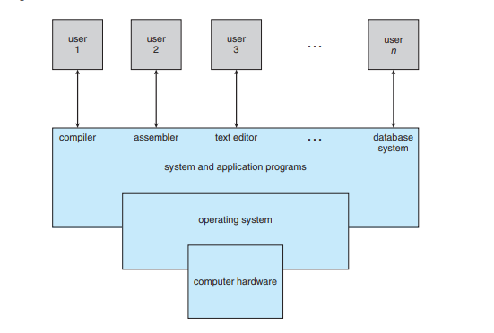
OBJECTIVES
• To describe the basic organization of computer systems.
• To provide a grand tour of the major components of operating systems.
• To give an overview of the many types of computing environments.
• To explore several open-source operating systems

Slide 4
FUNCTIONS
Convenience: An OS makes a computer more convenient to use.
• Efficiency: An OS allows the computer system resources to be used in an efficient manner.
• Ability to evolve: An OS should be constructed in such a way as to permit the effective development, testing, and introduction of new system functions without interfering with service

Slide 5
EVOLUTION
Serial Processing :
With the earliest computers, from the late 1940s to the mid-1950s, the programmer interacted directly with the computer hardware; there was no OS. These computers were run from a console consisting of display lights, toggle switches, some form of input device, and a printer. Programs in machine code were loaded via the input device (e.g., a card reader). If an error halted the program, the error condition was indicated by the lights. If the program proceeded to a normal completion, the output appeared on the printer. These early systems presented two main problems:
A) Scheduling:
Most installations used a hardcopy sign-up sheet to reserve computer time. Typically, a user could sign up for a block of time in multiples of a half hour or so. A user might sign up for an hour and finish in 45 minutes; this would result in wasted computer processing time. On the other hand, the user might run into problems, not finish in the allotted time, and be forced to stop before resolving the problem.
B) Setup time:
A single program, called a job , could involve loading the compiler plus the high-level language program (source program) into memory, saving the compiled program (object program) and then loading and linking together the object program and common functions.

Slide 6
Operating System Structures
1- layered
2- Monolithic
3- Microkernel

Slide 7
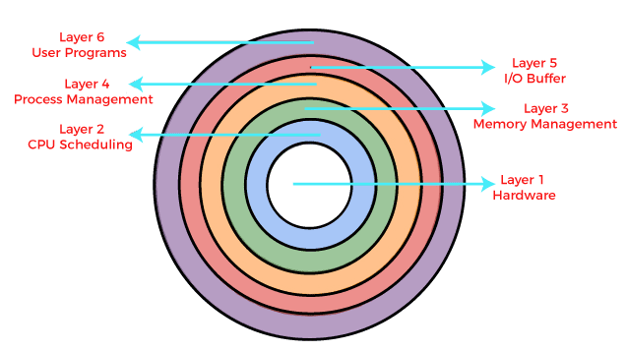
Layered Structure is a type of system structure in which the different services of the operating system are split into various layers, where each layer has a specific well-defined task to perform

Slide 8
Advantages :
Modularity :- This design promotes modularity as each layer performs only the tasks it is scheduled to perform.
Easy debugging :- As the layers are discrete so it is very easy to debug. Suppose an error occurs in the CPU scheduling layer, so the developer can only search that particular layer to debug, unlike the Monolithic system in which all the services are present together.
Easy update : -A modification made in a particular layer will not affect the other layers.
No direct access to hardware :- The hardware layer is the innermost layer present in the design. So a user can use the services of hardware but cannot directly modify or access it, unlike the Simple system in which the user had direct access to the hardware.
Abstraction :-Every layer is concerned with its own functions. So the functions and implementations of the other layers are abstract to it.

Slide 9
Disadvantages :
Though this system has several advantages over the Monolithic and Simple design, there are also some disadvantages as follows.
Complex and careful implementation :-As a layer can access the services of the layers below it, so the arrangement of the layers must be done carefully. For example, the backing storage layer uses the services of the memory management layer. So it must be kept below the memory management layer. Thus with great modularity comes complex implementation.
Slower in execution :-If a layer wants to interact with another layer, it sends a request that has to travel through all the layers present in between the two interacting layers. Thus it increases response time, unlike the Monolithic system which is faster than this. Thus an increase in the number of layers may lead to a very inefficient design.

Slide 10
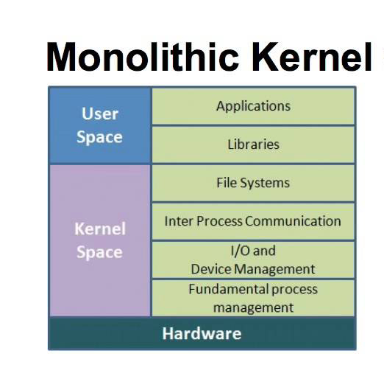
A monolithic kernel is an operating system architecture where the entire operating system is working in kernel space.

Slide 11
Advantages :
The execution of the monolithic kernel is quite fast as the services such as memory management, file management, process scheduling, etc., are implemented under the same address space.
A process runs completely in single address space in the monolithic kernel.
The monolithic kernel is a static single binary file.
Disadvantages :
If any service fails in the monolithic kernel, it leads to the failure of the entire system.
The entire operating system needs to be modified by the user to add any new service.

Slide 12
Features of Monolithic System
The monolithic operating system provides the following features to the users, such as:
Simple structure: This type of operating system has a simple structure. All the components needed for processing are embedded into the kernel.
Works for smaller tasks: It works better for performing smaller tasks as it can handle limited resources.
Communication between components: All the components can directly communicate with each other and also with the kernel.
Fast operating system: The code to make a monolithic kernel is very fast and robust.

Slide 13
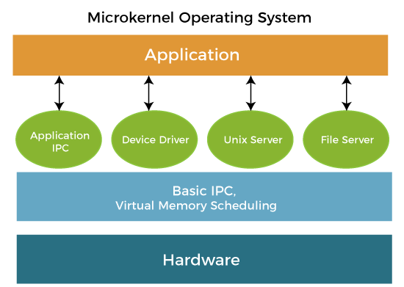
A microkernel is a kernel type that provides low-level address space management, thread management, and interprocess communication to implement an operating system.

Slide 14
Advantages :
The architecture of this kernel is small and isolated hence it can function better.
Expansion of the system is easier, it is simply added to the system application without disturbing the kernel.
Disadvantages :
In a microkernel system, providing services are more costly than in a traditional monolithic system.
The performance of a microkernel system might be indifferent and cause issues.

Slide 15
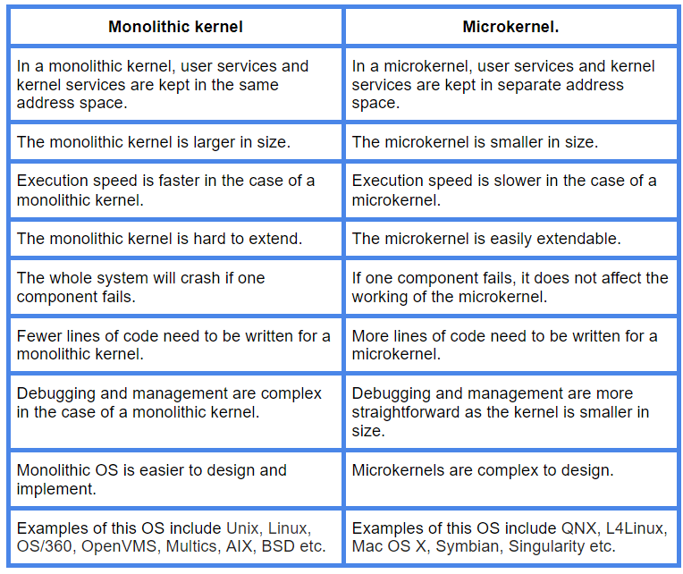

Slide 16
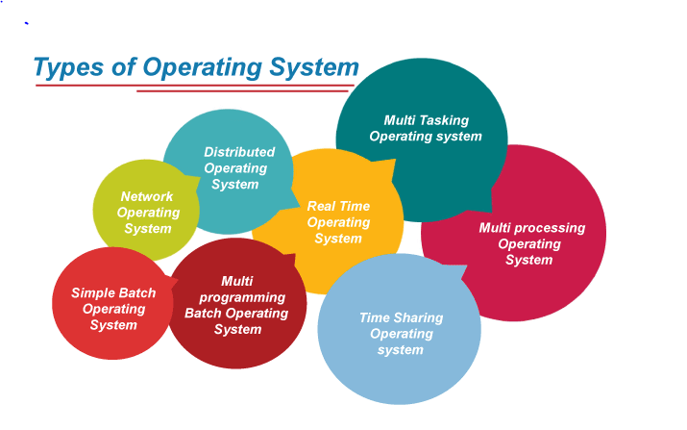
Types of Operating Systems

Slide 17
Simple Batch Systems
Early computers were very expensive, and therefore it was important to maximize processor utilization. The wasted time due to scheduling and setup time was unacceptable. To improve utilization, the concept of a batch OS was developed. It appears that the first batch OS (and the first OS of any kind) was developed in the mid-1950s by General Motors for use on an IBM 701 [WEIZ81].
The concept was subsequently refined and implemented on the IBM 704 by a number of IBM customers. By the early 1960s, a number of vendors had developed batch operating systems for their computer systems. IBSYS, the IBM OS for the 7090/7094 computers, is particularly notable because of its widespread influence on other systems. The central idea behind the simple batch-processing scheme is the use of a piece of software known as the monitor .
With this type of OS, the user no longer has direct access to the processor. Instead, the user submits the job on cards or tape to a computer operator, who batches the jobs together sequentially and places the entire batch on an input device, for use by the monitor. Each program is constructed to branch back to the monitor when it completes processing, at which point the monitor automatically begins loading the next program

Slide 18
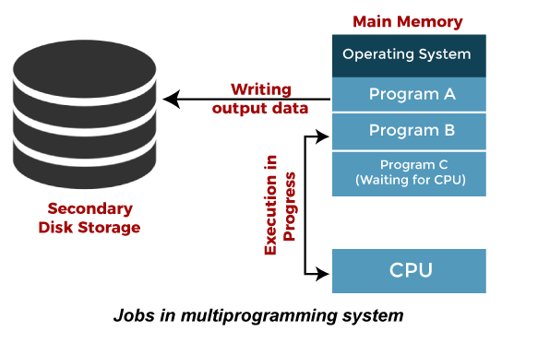
Multiprogramming Operating System
Multiprogramming is an extension to batch processing where the CPU is always kept busy. Each process needs two types of system time: CPU time and IO time.
In a multiprogramming environment, when a process does its I/O, The CPU can start the execution of other processes. Therefore, multiprogramming improves the efficiency of the system.
Advantages of Multiprogramming OS
Throughout the system, it increased as the CPU always had one program to execute.
Response time can also be reduced.
Disadvantages of Multiprogramming OS
Multiprogramming systems provide an environment in which various systems resources are used efficiently, but they do not provide any user interaction with the computer system.

Slide 19
Multitasking Operating System
The multitasking operating system is a logical extension of a multiprogramming system that enables multiple programs simultaneously. It allows a user to perform more than one computer task at the same time.
Advantages of Multitasking operating system
This operating system is more suited to supporting multiple users simultaneously.
The multitasking operating systems have well-defined memory management.
Disadvantages of Multitasking operating system
The multiple processors are busier at the same time to complete any task in a multitasking environment, so the CPU generates more heat.

Slide 20
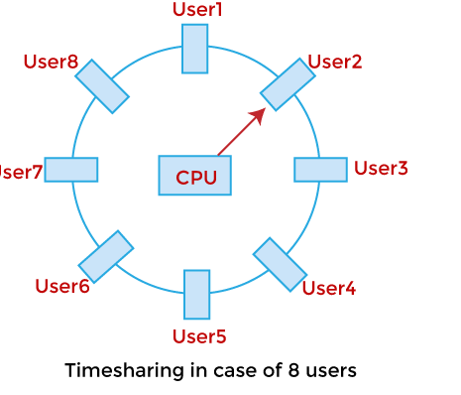
Time-Sharing Operating System
In the Time Sharing operating system, computer resources are allocated in a time-dependent fashion to several programs simultaneously. Thus it helps to provide a large number of user's direct access to the main computer. It is a logical extension of multiprogramming. In time-sharing, the CPU is switched among multiple programs given by different users on a scheduled basis.
A time-sharing operating system allows many users to be served simultaneously, so sophisticated CPU scheduling schemes and Input/output management are required.
Advantages of Time Sharing Operating System
The time-sharing operating system provides effective utilization and sharing of resources.
This system reduces CPU idle and response time.
Disadvantages of Time Sharing Operating System
Data transmission rates are very high in comparison to other methods.
Security and integrity of user programs loaded in memory and data need to be maintained as many users access the system at the same time.

Slide 21
Distributed Operating System
The Distributed Operating system is not installed on a single machine, it is divided into parts, and these parts are loaded on different machines. A part of the distributed Operating system is installed on each machine to make their communication possible. Distributed Operating systems are much more complex, large, and sophisticated than Network operating systems because they also have to take care of varying networking protocols.
Advantages of Distributed Operating System
The distributed operating system provides sharing of resources.
This type of system is fault-tolerant.
Disadvantages of Distributed Operating System
Protocol overhead can dominate computation cost.

Slide 22
Mobile Operating System
A mobile operating system is an operating system that helps to run other application software on mobile devices. It is the same kind of software as the famous computer operating systems like Linux and Windows, but now they are light and simple to some extent.
The operating systems found on smartphones include Symbian OS, iPhone OS, RIM's BlackBerry, Windows Mobile, Palm WebOS, Android, and Maemo. Android, WebOS, and Maemo are all derived from Linux. The iPhone OS originated from BSD and NeXTSTEP, which are related to Unix.

Slide 23
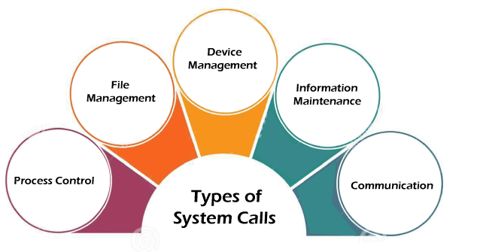
System Calls in Operating System
A system call is a way for a user program to interface with the operating system. The program requests several services, and the OS responds by invoking a series of system calls to satisfy the request. A system call can be written in assembly language or a high-level language like C or Pascal. System calls are predefined functions that the operating system may directly invoke if a high-level language is used.
A system call is a method for a computer program to request a service from the kernel of the operating system on which it is running. A system call is a method of interacting with the operating system via programs. A system call is a request from computer software to an operating system's kernel.

